Slide 1
Design Patterns

Slide 2
What are Design Patterns?
A way of formalizing software development
A way of thinking about how you approach solving a problem
Don’t just make the thing in a haphazard way
Make the thing with purpose, intent
Describe the process you used to make it
Why? So you (or someone else) can make something else in a similar way

Slide 3
Analogy Time!
Let’s say you want to build a house – what are the steps to make that happen?
Get some… house building… stuff
Put that stuff together… the way it’s supposed to be done… How hard could this be?
Eventually you get a house!
(If you think this sounds okay… please keep that to yourself)
Imagine contacting some architect / construction company, and getting that as a response…

Slide 4
A tried and true process is a good thing
There’s a lot of formality and to this process, so multiple people can work on it
Building the house might entail…
Leveling off the build site
Pouring a foundation
Building a basic frame for walls and floors
Plumbing, electrical systems
Building the roof
Etc…
You can modify some of these stages as needed for a custom solution
Software is the same idea:
First you learn the rules.
Then you learn which rules are RULES and which rules are “rules”

Slide 5
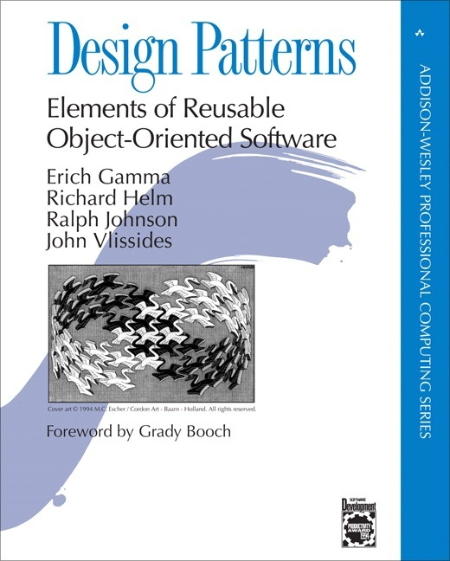
Design patterns – when did they come around?
Formalized in 1994
Written by a group of software engineers dubbed “The Gang of Four”
The “GOF Book”
23 patterns to describe reusable parts of a program
This is NOT a book on “How to program”
It assumes you KNOW how… but you want to leverage you skills to write better software, more easily

Slide 6
Invented or discovered?
Documented solutions
What worked well in a particular project?
Could that be done again?
Would this help on another, different project?
Completely different project? There are NO similarities of any kind?
Or… different on the outside (to the user), but similar on the inside
Houses have a lot of similarities, even when they’re different. Cars, computers, etc…
As you learn more about programming, you learn to think differently about programs
Not just as a user, but as a creator

Slide 7
Patterns lead to… design patterns
ProjectB
Potential for a design pattern!
More potential patterns!
The software could be very different: (3D Modeling software vs PowerPoint)
ProjectA
ProjectC
Which part(s) of your SOLUTION to ProjectA and ProjectB were similar?
Choice of data structure(s)? Algorithm?
Optimization Technique?

Slide 8
How many design patterns are there?
Gang of 4 described 23 patterns in their book
More can be created, but these are the best-documented ones
You will almost certainly create some pattern in your own project(s)
May bear similarities to existing patterns
May be insufficiently different to be considered something new

Slide 9
What do they DO?
Broken into 3 categories:
Creational – How can we create objects?
Structural – How can we create complex objects, or collections of objects?
Behavioral – What can we have these objects DO?

Slide 10
23 Design Patterns from the Gang of Four
Abstract Factory
Adapter
Bridge
Builder
Chain of Responsibility
Command
Composite
Decorator
Façade
Factory Method
Flyweight
Interpreter
Iterator
Mediator
Memento
Observer
Prototype
Proxy
Singleton
State
Strategy
Template Method
Visitor
You don’t have to learn them all, and some you might use far more frequently than others

Slide 11
How can they help?
Formalizing the process lets you describe the solution to the problem
If you can talk about it, you can talk about whether or not it works
Example: A conversation about arrays vs vectors vs linked lists
Pros and cons? Are they interchangeable?
If it’s just magic to you, you can’t analyze it
Hopefully none of those are still magic to you… #sadinstructor

Slide 12
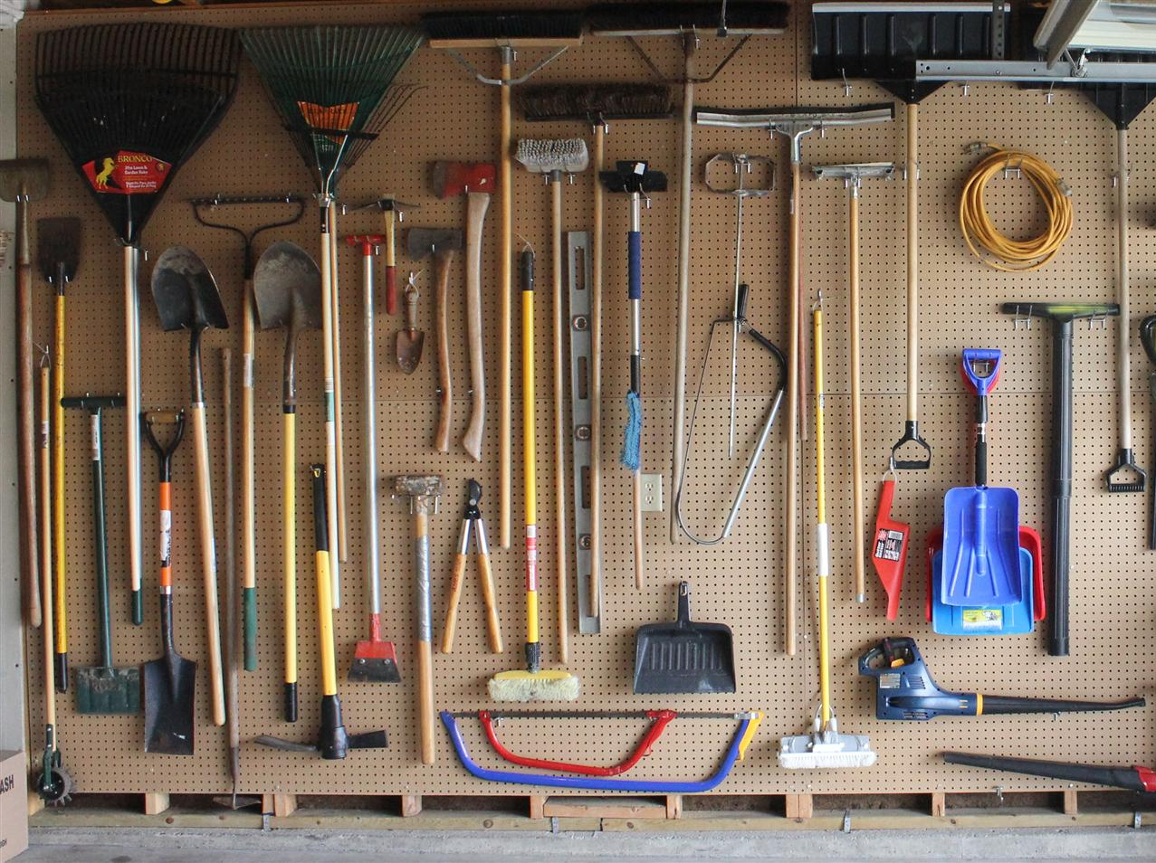
Should I use all of them in my projects?
No
Choose the right tool for the job
A shovel is great for digging or filling holes
Not so good at pounding nails, removing screws, raking leaves, etc

Slide 13
Right tool for the job
ProjectB
Could be a terrible choice to use here
This pattern…
ProjectA
ProjectC
Projects A and C might be similar, but in a way that’s different than the A/B relationship
How do you know? Learn about it, think about it, try it out, screw it up, try again, etc…

Slide 14
So… which one(s) do I use?
Whichever pattern(s) best suit your needs
How do you determine that?
First, learn about the patterns, try them out
Example: The Observer pattern is used when an object needs to know about another object’s updates
(Object A “watches” Object B, gets notified of changes)
Try it out: Write a simple program that has classes A and B, and when B updates, A gets notified
Learning about, and implementing a simple example could take a few minutes, or a few hours, depending on the complexity of your test

Slide 15
Now that it works… will it work for YOU?
Identify parts of your application where this pattern might be effective
Does this system need to know about that other system?
Will an Observer work in this scenario? TRY IT OUT
Did it work? Why or why not?
Was it easy(ish) to implement?
Was it helpful to other parts of your code (or other people on your team)?

Slide 16
Future projects
Need to implement feature XYZ
“Hmm, an Observer pattern would probably help solve this problem easily…”
OR…
An Observer pattern wouldn’t help that at all, because…
Instead, that might be more of a… <Other Pattern>
Or maybe no existing pattern fits that particular problem
You create your own solution from scratch
Same concept as: “Would a map or a vector be better in this situation?”

Slide 17
What if you need to alter the pattern?
Alter away!
Design patterns are “formal” in that they have a prescribed structure
That structure might not perfectly fit your application as-is
Rework as needed
Be cautious, and certain your changes must occur the way you think they should

Slide 18
Structure of a Design Pattern
What it is
Why/When to use it
What other patterns might connect to it
Related patterns

Slide 19

Visualization of Design Patterns
UML – Unified Modeling Language, a way of representing complex systems
(Sometimes) easier to design/redesign a system without actually writing any code for it
We talked about this before with just a few comments describing the code… before writing the code

Slide 20
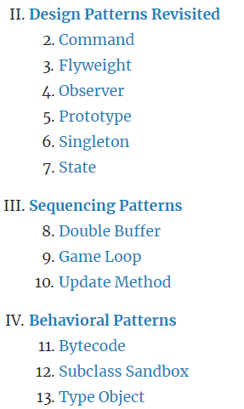
Beyond the GOF
http://gameprogrammingpatterns.com/
The same concept—a formal look at reusable components/structures—but applied to games
You may create patterns of your own across multiple projects
You may develop a certain style/preference over time
And more…

Slide 21
Anti-Patterns
The opposite of design patterns
If design patterns are helpful, then anti-patterns are:
Things you have probably done or will do some day
But you should probably avoid…
They may be things that you (or your team) do unintentionally
Originally coined to describe bad practices in software, might also be applied to problem solving in general
May often be used to describe issues not specific to code

Slide 22
Anti-Pattern: Bicycle Shed
Want to build something big and impressive, like a football stadium?
What should be focus of the design or architectural work? What should have the most effort put into it?
The parking structures? Load-bearing supports for all of the seats? What about a dome? Sound system?
Hmm, those sound like hard problems to solve…
What about the bicycle shed used by employees?
Easy to figure out, let’s focus on that!
Build the most impressive bike shed ever!
The same can be done with code. Write code to solve easy stuff, and focus on that…
…while avoid the more difficult aspects of a project
Some design patterns may drawbacks to them, and may be considered anti-patterns if not implemented carefully

Slide 23
Recap
Design patterns are known solutions to common problems in software development
You may be able to implement these in your own programs to solve (or help solve) some aspects
These patterns are conceptual; the exact implementations may vary
Not all patterns are applicable to all programs
Being aware of the existence of patterns may help you build software more quickly
Anti-patterns also exist, and being aware of them may also help build software more quickly (by dodging pitfalls)

